Slide 1
Digital to Analog Mini Headend System manufactured
By
Trivision Broadband and Telecom Inc.

Slide 2
The Challenge
As cable companies migrate to an all-digital distribution system each TV at customer’s premise requires a Digital Set-Top Box (STB) or DTA installation. In multi-screened environments such as:
  Sports bars & restaurants
  Hotels & motels
  Health centers
  Correction facilities
  Educational facilities
  Fitness centers
  Small communities
  Commercial facilities
-

Slide 3
The Solution
-
The Mini Headend (Compass-12) bridges the gap by combining random channels from Cable Company’s digital set-top boxes with analog modulators. The analog channels are delivered utilizing existing cabling at customer’s facility with simple installation of Compass-12 at a designated central location.

Slide 4
How it works
Each Digital Set Top acts as dedicated Digital receiver, paired with an
analog modulator set to specific channel.
The infrared command for STB is directed via dip switch selector for
selected STB infrared receiver enabling. Front panel remote control
receiving feature on each STB is enabled/disabled individually for
perfect operation.
Customer chooses number of channels and channel plan that works
best for their requirement.
The channel selection on each STB can be programmed at cable
company’s facility ahead of installation for true PLUG and PLAY
installation or channels can also be programmed at installation site.
The system is scalable form 12-channels to any number of channels by
adding additional Compass-12 in the same location.

Slide 5
How it works
The system is assembled in a mini rack configuration, fully tested and burned-in
for long term operational integrity.
Each STB is upgraded with a dedicated feature (designed by Trivision) for
auto power On during power interruption and infrared enable/disable control
function for individual channel programming.
The system is designed such that during power interruption all programmed
channels on STB will remain intact upon power resumption.
The system is fully portable and it can be hanged on four bolts on the wall or
placed on a firm surface.
The system is designed to work as PLUG and PLAY device requiring Cable IN,
Cable Out and AC power.
The system remains fully in control of Cable company.
The unit comes with 1-year parts and labor Warranty.

Slide 6
Basic Block Diagram
Cable In
Drop Amp
-20dB TP
D/C
12-Way Splitter
Controller
Upgraded E940 / DCX700 Digital Set Top
Power Supply
Composite Video/Audio input
Agile Modulators
Power Supply
Web
12-Way Splitter
Video streaming back to control (optional)
D/C
-20dB TP
Operator ‘s Remote Access provides channels control as well as viewing of all channels at customer site(Optional)
New Optional Addition
Cable distribution output

Slide 7
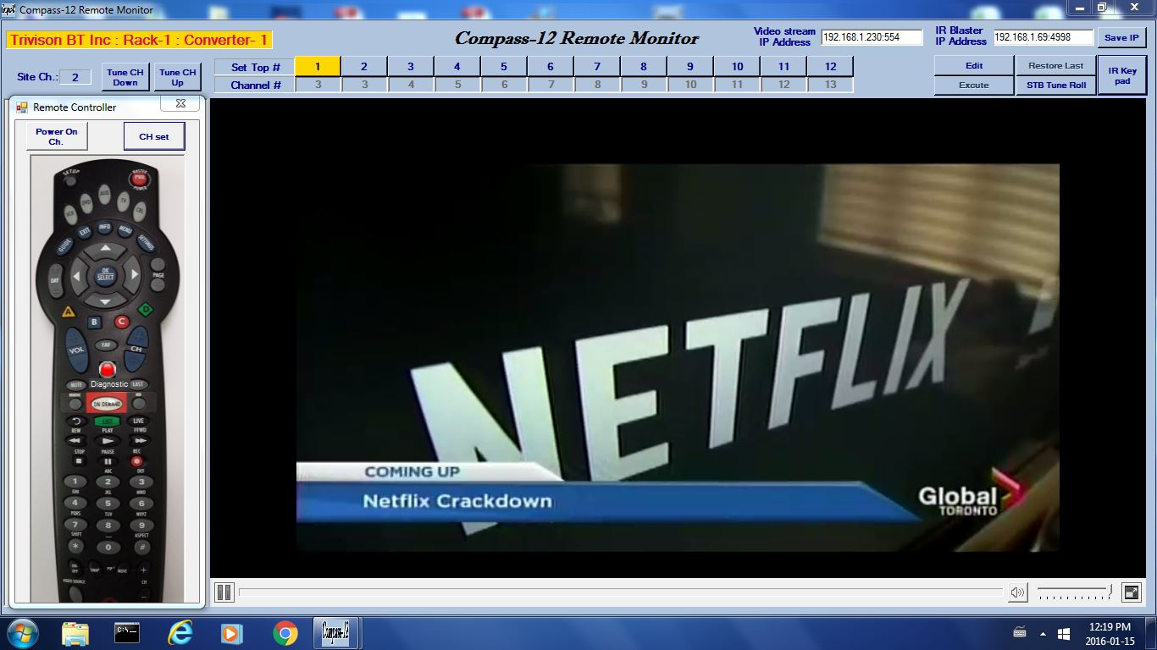
Channel line-up at any customer site can be changed instantly via web access from
any remote location. IR Remote features can be exercised easily. (optional)

Slide 8
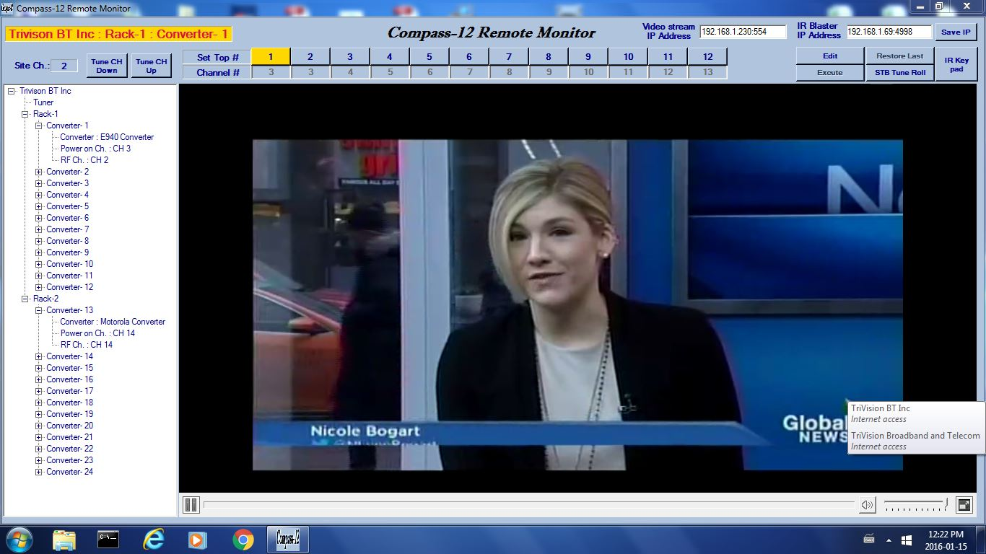
Real Time Monitoring of all chassis and each channel via web access from any location. Optional

Slide 9
Optional Remote Access
The Operator can access D/A Mini Headend remotely via
WEB
All channels can be viewed as well as programmed by the
operator
Each Mini Headend is assigned with a unique address
Host server is equipped with static IP address and it resides
at a location defined by operator.
Mini headend automatically finds Host server and remains
connected

Slide 10
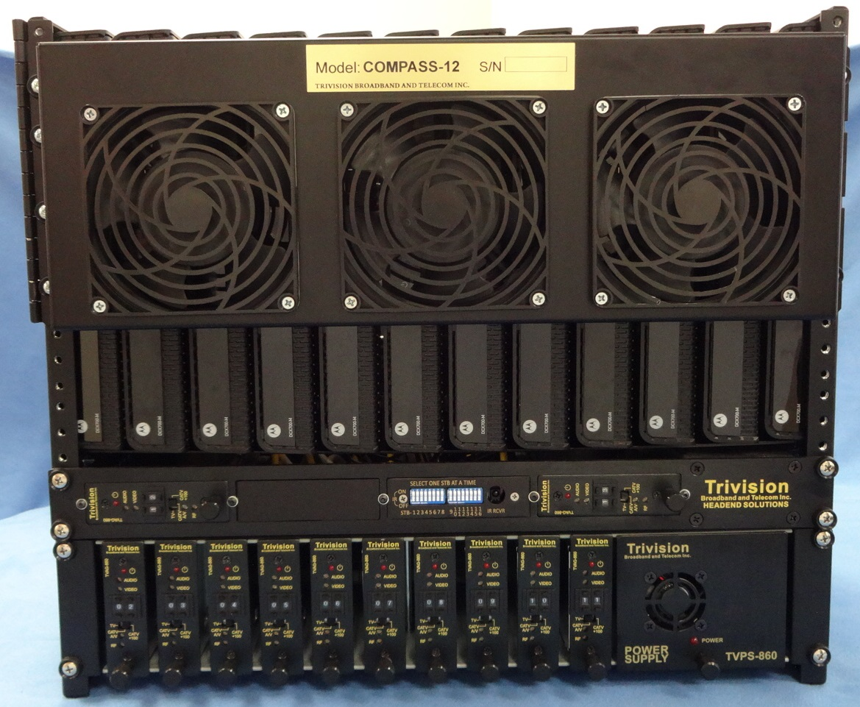
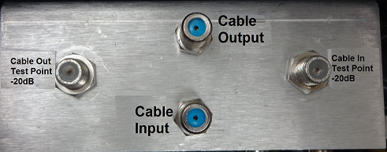
Easy installation RF Connections required -Cable Input -Cable output
Cable In: 7dB to 12dB
Cable out: 26+3dB
Front view of 12-Channel Digital to Analog Mini Headend

Slide 11


Example of several units operating in one facility. Each unit offers 12-channels
Additional units
Combiner
To Cable Distribution Network

Slide 12
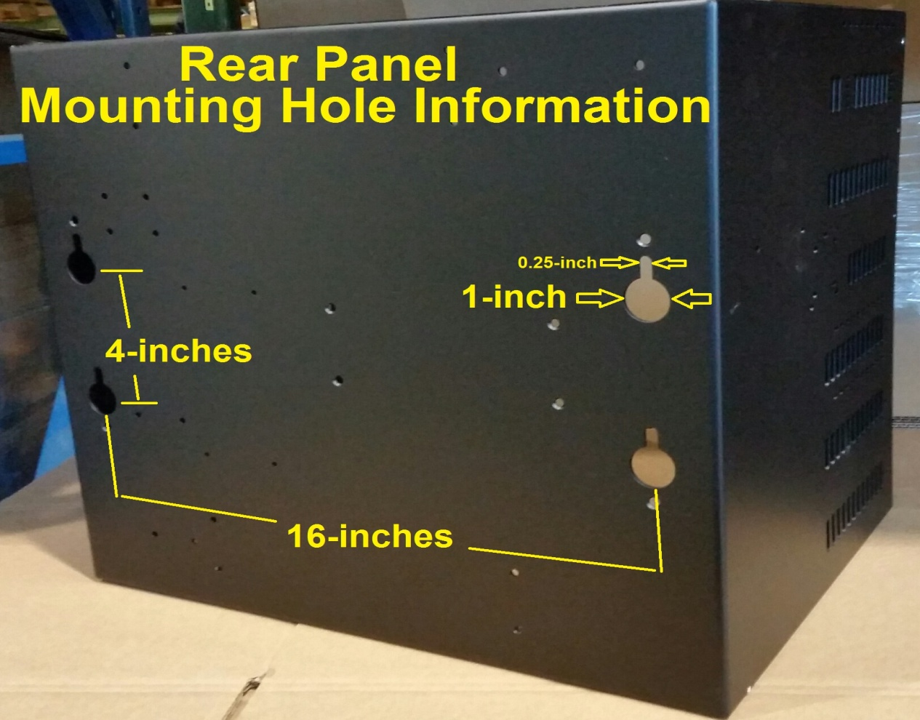
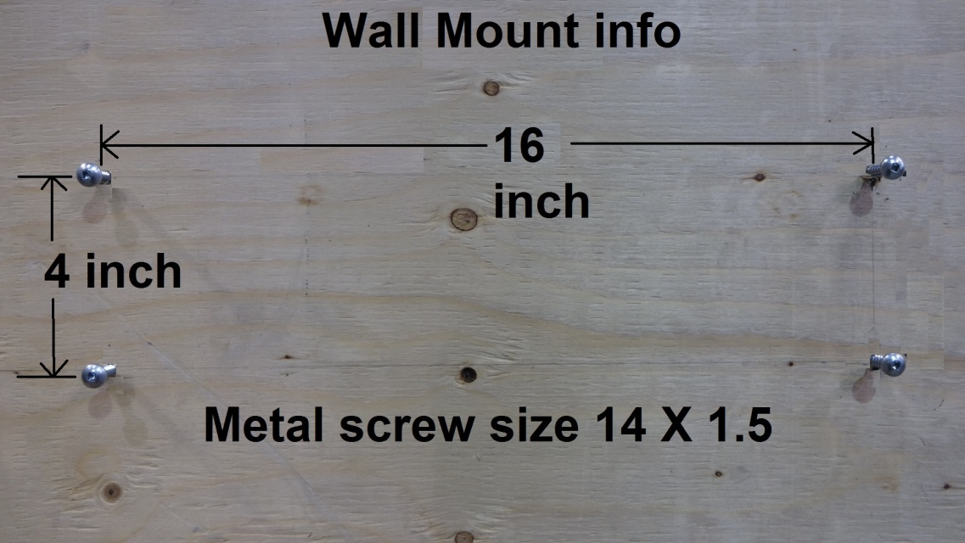
Compass-12 Installation
Compass-12 Rear Panel Mounting Holes Information
Mark balance 16” and 4” location and install four screws as per the diagram.
Easy installation, Insert screw in the hole and Drop

Slide 13
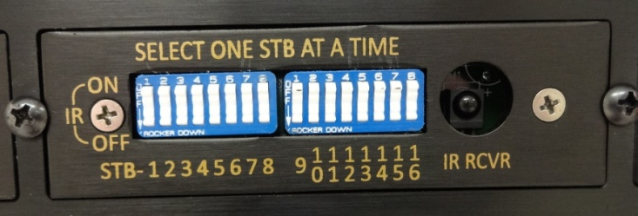
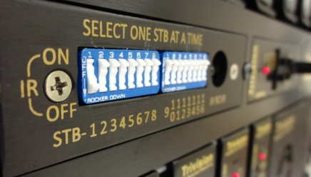
Individual Set Top Infrared enable and Programming Board
Enable desired individual STB infrared receiver from 1 to 12, using dip switch block on the front panel. Each individual dip switch enables IR Receiver of corresponding STB number
Common infrared sensor for all STB channel programming
For example, to program STB-1 turn “ON” STB-1dip switch on the front panel of Compass-12, Upon completion of programming turn dip switch number “1” to off position and repeat same step for additional STB channel programming

Slide 14
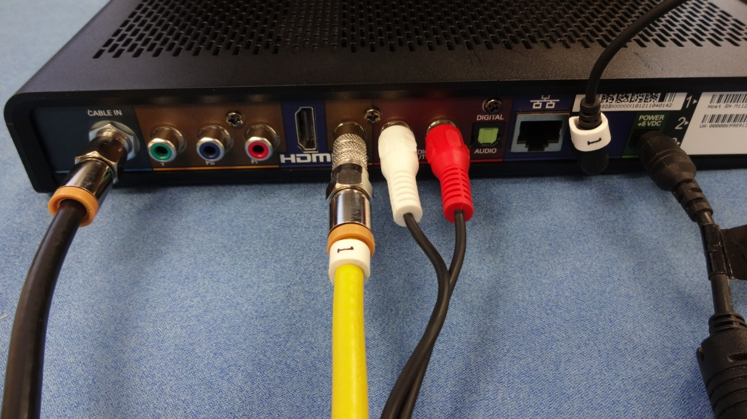
Individual Set Top connection requirement
IR IN
RF IN
Video Out
Power In
Audio Out
STB Model Arris (Motorola) DCX700

Slide 15
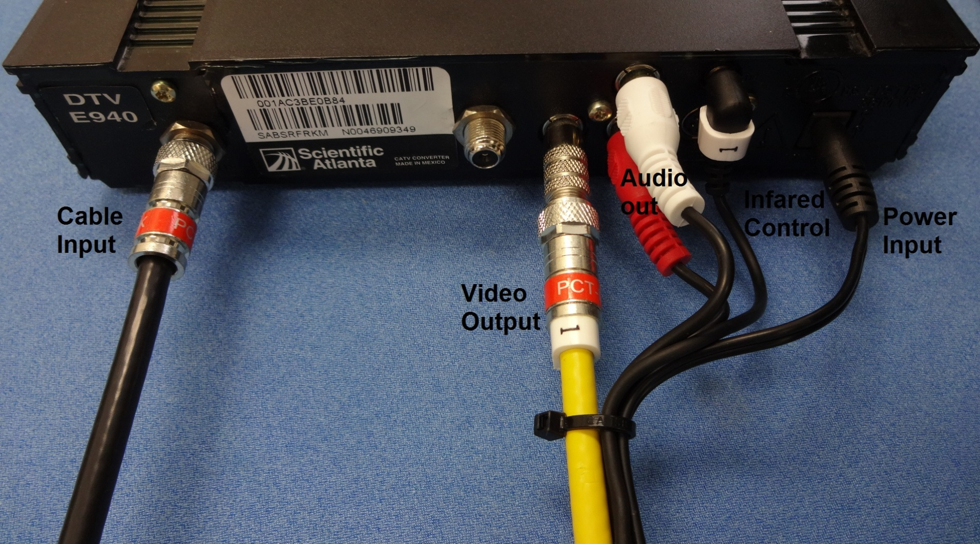
Individual Set Top connection requirement
STB Model Cisco E940

Slide 16
For further detail please consult Installation and operation Manual
Thank you
Trivision Broadband and Telecom Inc.
7880 Woodbine Ave
Markham Ontario
L6C1B1
905-4741422
WWW.Trivisionbtinc.com

